Slide 1
Understanding Dependencies and Frameworks in Javascript

Slide 2
Outline
Dependency Management
What are dependencies and why you need them
Node Package Manager(NPM)
Bower
Javascript Frameworks
AngularJS
JQuery
Software Design Patterns
Model View Controller
Model View Presenter
Naked objects
Developing Single Page Applications with AngularJS

Slide 3
Dependency Management with npm and Bower

Slide 4
What are Dependencies?
Dependencies are external (3rd Party) components injected into a project whose functionality is relied upon.
Whenever a class A uses another class or interface B, then A depends on B. A cannot carry out it's work without B, and A cannot be reused without also reusing B. In such a situation the class A is called the "dependant" and the class or interface B is called the "dependency". A dependant depends on its dependencies.
Dependencies are injected into using Package Managers, popular among them include Bower, NPM, Maven and Gradle.

Slide 5
Node Package Manager
Node Package Manager or NPM is a javascript dependency injector that is bundled along with NodeJS
NPM consist of a command line tool that injects dependencies into a dependent project.
Installing dependency(library or component) is by simply typing the npm install <package_name> and you will get NPM Installed on your project
Need More? https://docs.npmjs.com/getting-started

Slide 6
Bower
Bower is a package manager that makes it easy to manage all your application’s front-end dependencies.
Bower requires node, npm and git as such bower itself is a dependant that manages other dependencies,
Bower can be installed using NPM by typing npm install -g bower
Bower can then install other packages like jquery by simply typing bower install jquery
More info? - https://bower.io/

Slide 7
Using MVC as a design Pattern

Slide 8
Model View Controller
Model–view–controller (MVC) is a software design pattern for implementing user interfaces on computers.
MVC divides a given software application into three interconnected parts, so as to separate internal representations of information
The three interconnected parts are
The Model directly manages the data, logic, and rules of the application.
The view can be any output representation of information, such as a chart or a diagram. Multiple views of the same information are possible, such as a bar chart for management and a tabular view for accountants and
The Controller, accepts input and converts it to commands for the model or view

Slide 9

Graphical Representation of MVC

Slide 10
Model–View–ViewModel
Model–view–view-model (MVVM) is a software architectural pattern that facilitates a separation of development of the graphical user interface.
Model–view–viewmodel is also referred to as model–view–binder and also have three major components that include:
Model refers to the data access layer, which represents content
As in the MVC pattern, the View is the structure, layout, and appearance of what a user sees on the screen
In the View Model, a binder mediates communication between the View and the Model. The view model is often described as a state of the data in the model

Slide 11
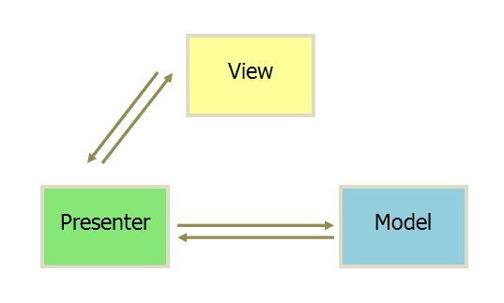
Graphical Representation of MVVP

Slide 12
Single Page Applications

Slide 13
What are Single Page Applications?
Single-Page Applications (SPAs) are Web apps that load a single HTML page and dynamically update that page as the user interacts with the app without going back to the server.
In an SPA, either all necessary code – HTML, JavaScript, and CSS – is retrieved with a single page load, or the appropriate resources are dynamically loaded and added to the page as necessary, usually in response to user actions, The page does not reload at any point in the process, nor does control transfer to another page.
Web browser JavaScript frameworks, such as AngularJS, Ember.js, Meteor.js, and React have adopted SPA principles.

